Slide 1
CHAPTER 2.8:
Inverse of a Sum and Simplifying
Algebra concepts

Slide 2
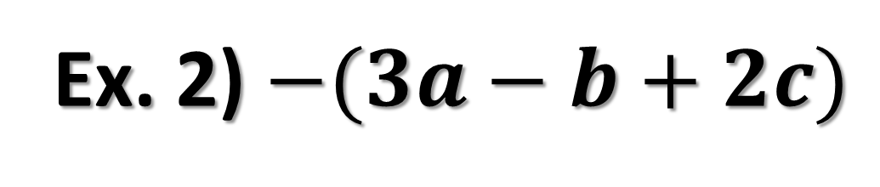
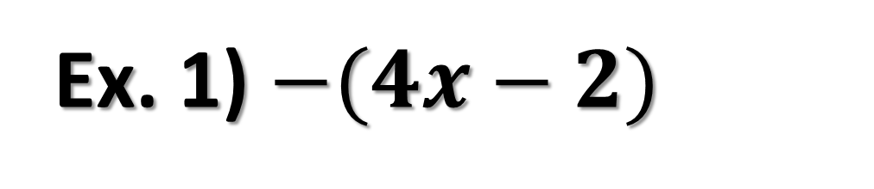
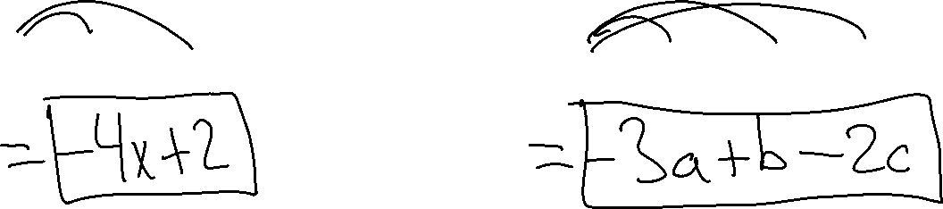
Inverse of a Sum Property
Ex. 1) $−(4x−2)$
Ex. 2) $−(3a−b+2c)$

Slide 3
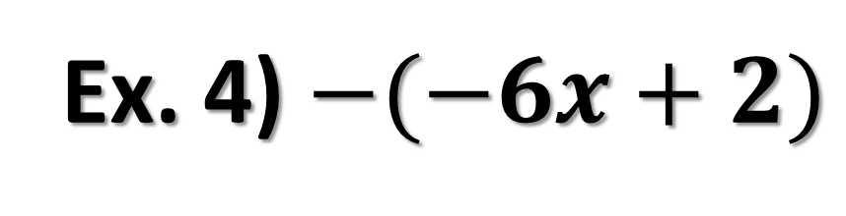
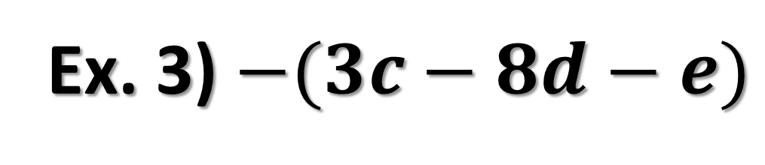
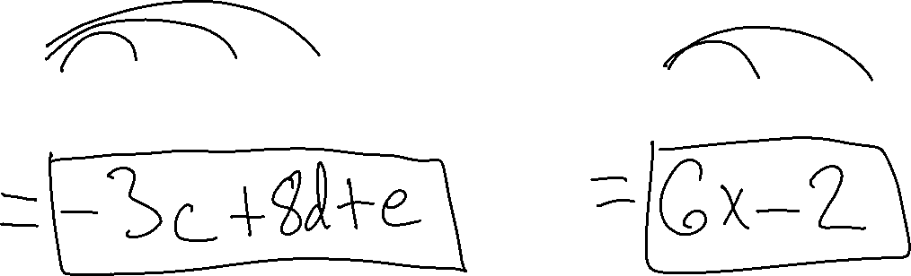
Ex. 3) $−(3c−8d−e)$
Ex. 4) $−(−6x+2)$

Slide 4
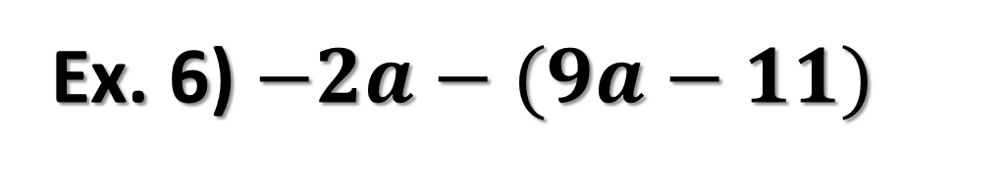

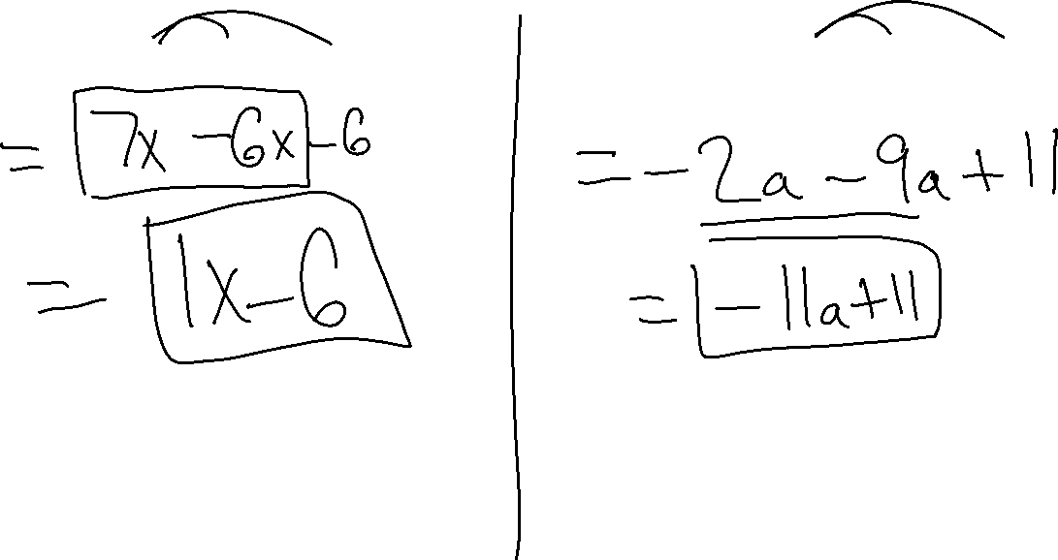
Simplifying Expressions Involving Parentheses
Ex. 5) $7x−(6x+1)$
Ex. 6) $−2a−(9a−11)$

Slide 5

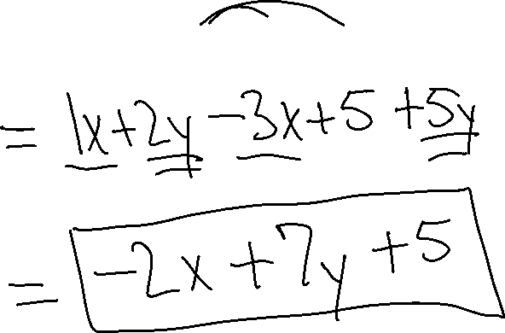
Simplifying Expressions Involving Parentheses
Ex. 7) $x+2y−\left(3x−5\right)+5y$

Slide 6

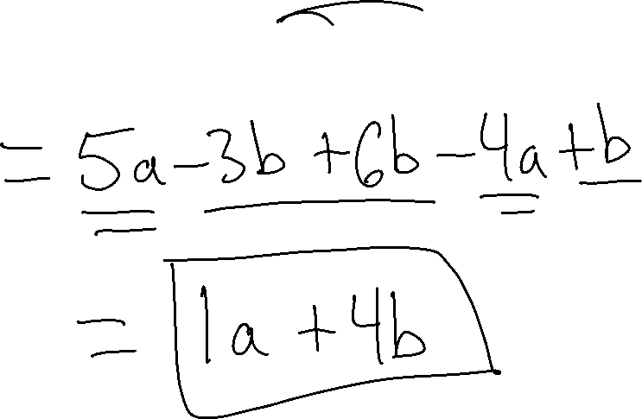
Simplifying Expressions Involving Parentheses
Ex. 8) $5a−3b−(−6b+4a)−(−b)$

